Slide 1

SDET Course
Design Patterns - Proxy

Slide 2
3 Types of Design Patterns
Creational
Singleton
Builder
Prototype
Factory Method
Abstract Factory
Structural
Adapter
Composite
Proxy
Flyweight
Bridge
Facade
Decorator
Behavioral
Strategy
Observer
Command
Memento
State
Template Method
Mediator
Chain of Responsibility
Interpreter
Visitor
Iterator

Slide 3
Agenda
Description
Diagram
Code sample (Java)
Use cases

Slide 4

Description
Introduction - The Lawyer

Slide 5
Description
The Proxy design pattern is a structural pattern that provides a surrogate or placeholder for another object to control access to it. Acting as an intermediary, the Proxy pattern allows for the implementation of additional functionality such as logging, caching, or access control without altering the original object's code. This pattern is beneficial in scenarios where the creation or usage of the real object is expensive or resource-intensive, as the proxy can defer the object's creation until it is actually needed. Additionally, the Proxy pattern can be used for implementing lazy initialization, access control, or providing a level of indirection to facilitate remote communication or asynchronous behavior.

Slide 6
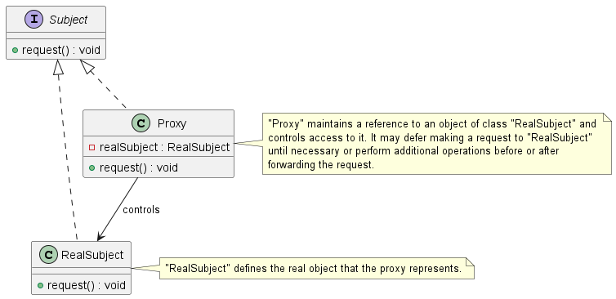
Class Diagram

Slide 7
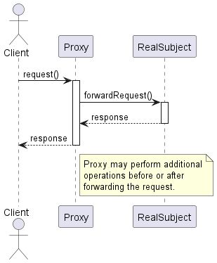
Sequence Diagram

Slide 8
Code Sample

Slide 9
General use cases
Access Control
Remote Object Access
Content Filtering
API Gateway (APIGEE / WSO2)

Slide 10
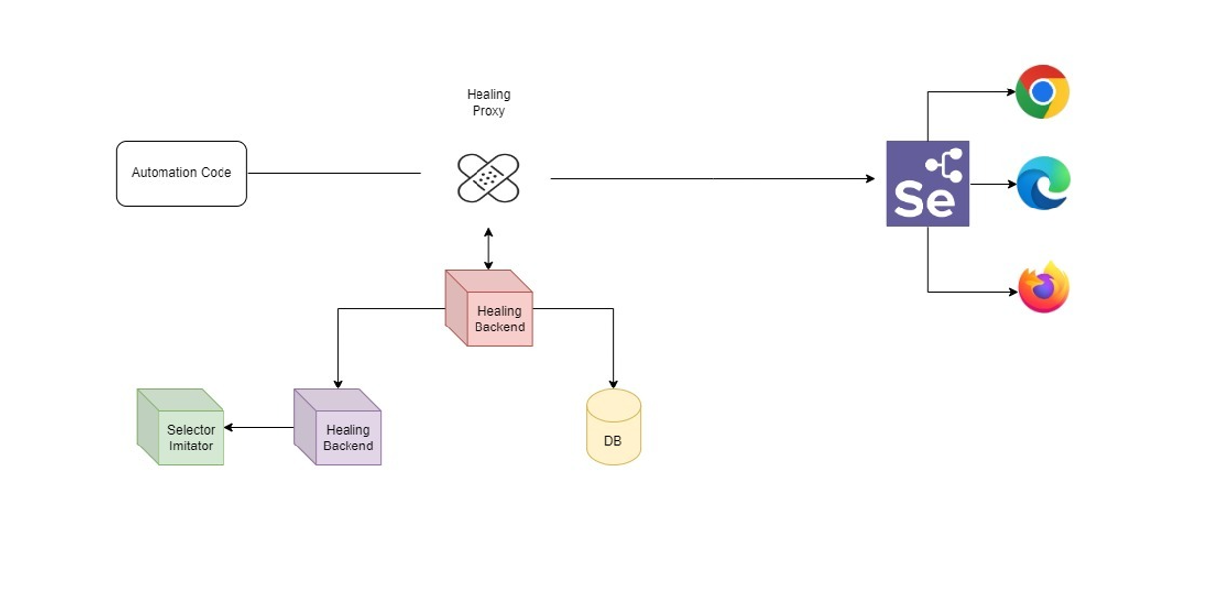
Use Cases in Test Automation
Healenium

Slide 11
Happy Coding

